Slide 1

Quality Alloys Web Analytics & Promotion
Hult International Business School
Data Science: R
Cohort 1, Team 4
JP Camino, Asmaa Abutaha, Surabhi Ghag, Nan Wang, Linghao Zhu, Emily Gomez

Slide 2
Value of QA’s Website
Objective:
Determine the value of QA’s website including:
Increased website traffic
Effect on product sales and revenue
Lasting impact

Slide 3
Website observations and data

Slide 4
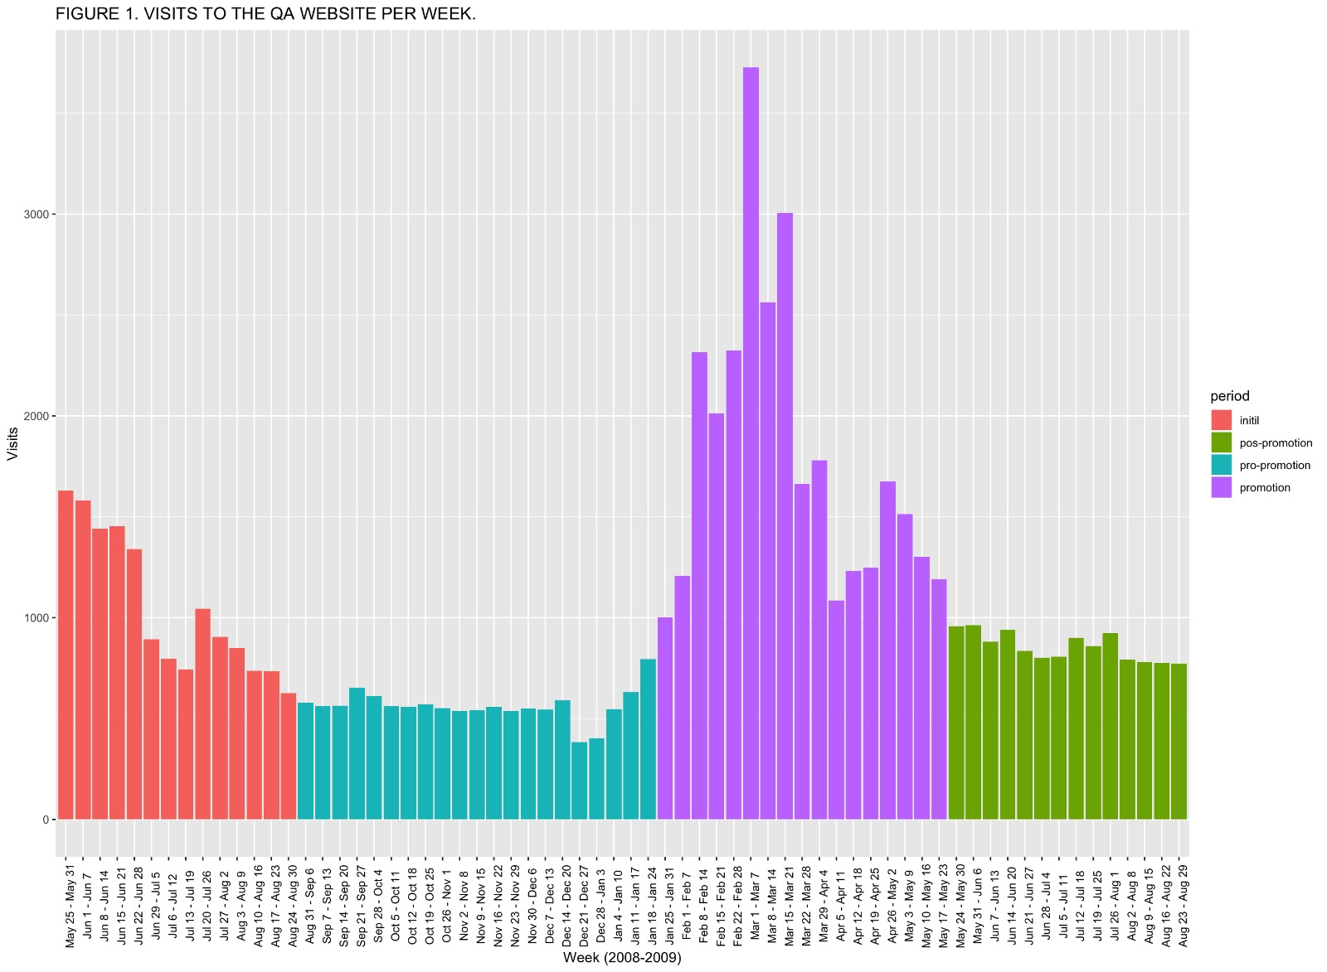
Website Visits
During the promotional period, the average weekly visits to the website increased. It also showed more variability with a larger standard deviation and range.
Notes:
********* get data from R: should match the PDF file
We did find an increase in the average daily visits to the website during the promotional period. However, this provides more insight into the effectiveness of the promotion on bringing more traffic to the website rather than the value that the website provides. Even though the promotional period has the highest mean, its median is the lowest. Its maximum is considerably higher, pulling the mean to the right. The data is skewed and does not follow a normal bell curve making it harder to predict visits reliably.
After the promotion, the average daily visits dropped expectedly due to the nature of the business. Considering that the website does not have a shopping cart and it is a B2b company with orders being unique occurrences, the nature of the website does not implore potential customers to visit repeatedly.

Slide 5
WEEKLY VISIT DEEP DIVE:
Period​ | % New Visits​ | Pages/ Visit​ | Ave. Time on Site (sec.)​ | Bounce Rate (%)​
Initial​ | 86.8​ | 2.28​ | 80​ | 67.3​
Pre-Promotional​ | 83.9​ | 2.67​ | 96​ | 59.4​
Promotional​ | 91.0​ | 1.80​ | 49​ | 77.3​
Post-Promotional​ | 86.3​ | 2.18​ | 70​ | 66.3​
Pages viewed per visit and the average time spent on the website both were lowest in the promotional period.​
In the post-promotional period, all values were lower than at the initial launch of the website.
This suggests that if the website does provide value with the promotion, the benefit is temporary and would not sustain itself.
Notes:
To look deeper into the weekly visits to the website, data was broken into 4 time frames: the initial launch of the website, the pre-promotion (where data had leveled off), the promotional period (where we see the effect of the promotion), and the post-promotional period (where numbers level off again). We used these time frames for much of our analysis.​
​
Looking deeper into the visits to the website, we see that although the number of visits and new visits increased, this does not signify that more time is spent on the website. In fact, people are looking at fewer pages and spending less time on the website. Their attention is initially brought to the website, but it does not seem to be held. Since we have no shopping cart, we can only infer based on other data whether the website is leading to added value.​
​
Businesses order what they need when they need it and it is not indicative of future sales or similar orders. Because of this, the website is not expected to be one that a customer would visit unless a circumstance requiring information came up, such as a new product. Therefore the percent of new visits is expected to always be high.​
​
What is more concerning from this information is that the bounce rate is so high in the promotional period. The bounce rate tells us about those potential customers that entered the website and closed it out from the opening page. The website failed to prompt more interest in anything that is not on the opening page.​

Slide 6
Revenue and Profit related to sales
Notes:
We’re going to switch gears and look at the financials of Quality Alloys to better understand the value of the website now that we know a little bit more about people coming to the website and their behavior once there.

Slide 7
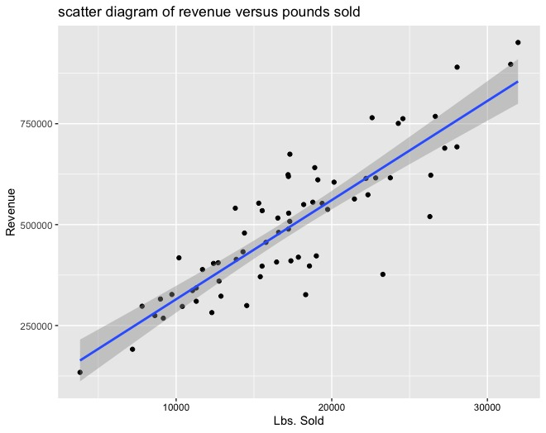
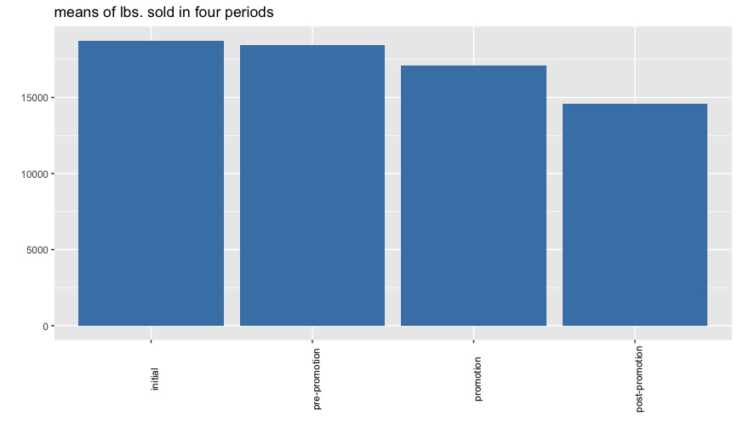
Revenues and Lbs. of product sold
There is a strong correlation between the lbs. sold and the revenue.
As shown in the bar chart, the lbs. sold decreased in each period from the initial launch of the website to post-promotion.
Notes:
Mean**** of lbs. sold

Slide 8
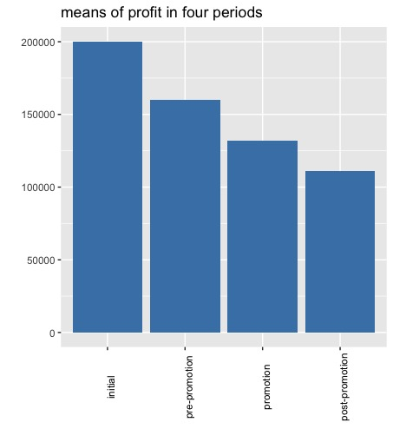
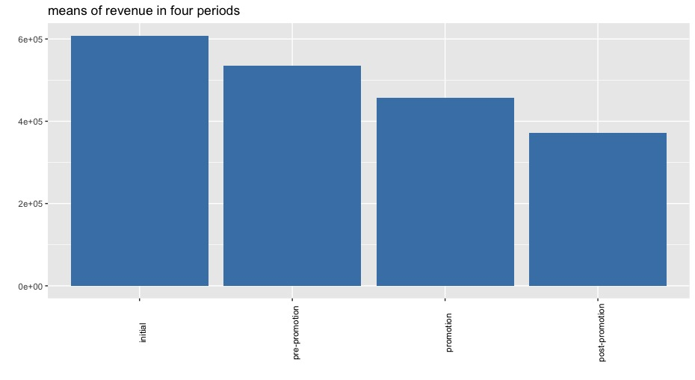
Revenue and Profit
Revenue and profits both decrease consistently from period to period.
The increase in website visits did not have a large enough effect to boost the revenue or profit to be a positive change during the promotional period.
Notes:
Revenue and profits both decrease consistently from period to period. Clearly the increase in website visits did not have a large enough effect to boost the revenue or profit to be a positive change during the promotional period.
Moreover, this is not the usual graph of a given level before and after the promotion while the promotional effect is isolated. Here we see a decrease every period suggesting that the promotion is not the only factor in changes in company performance.

Slide 9
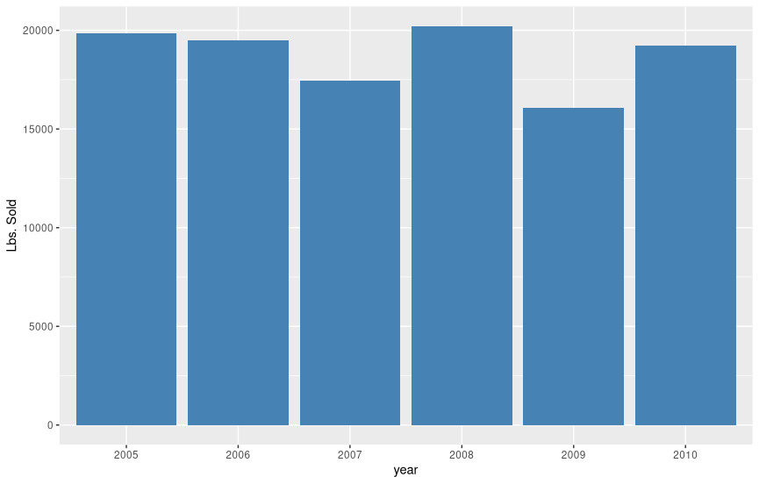
Lbs. Sold
Statistic | Before Website | After Website
Mean | 19384 | 17582
Median | 18382 | 17216
Standard Deviation | 7136 | 6222
Minimum | 4173 | 3826
Maximum | 44740 | 35669
Skewness | 0.690 | 0.375
Kurtosis | 0.577 | -0.002
*After the website was created and the promotion rolled out, the average lbs. sold decreased. Data through July 2010 shows some growth which may be due to economic conditions.
Notes:
********* get data from R: should match the PDF file
The lbs. sold do not follow a normal distribution exactly. The skewness and kurtosis are not extreme and a ballpark could be estimated but….

Slide 10
Website’s value

Slide 11
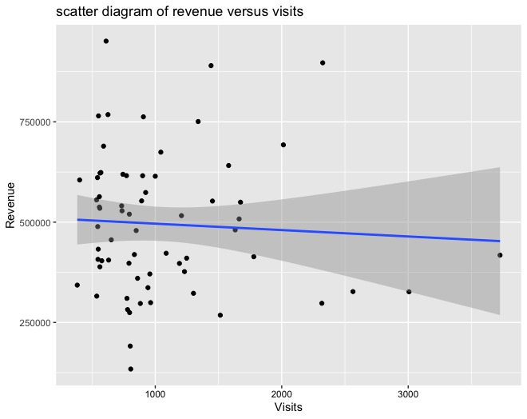
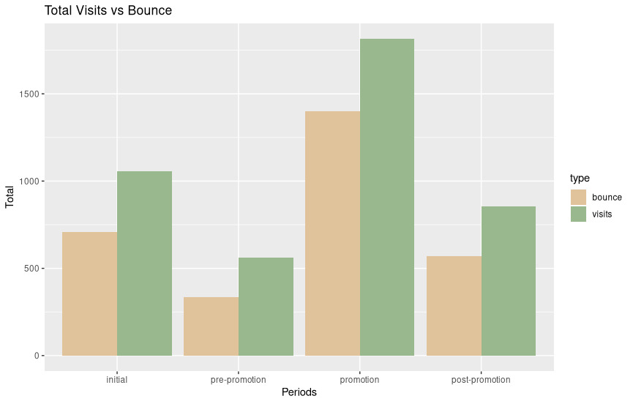
Visits in Relation to Revenue and Bounce
The scatter plot of revenue and number of visits shows that an increase in the number of visits cannot reliably be linked to an increase in revenue.
We can also compare the bounce rate with the total number of visits. Bounce rates and numbers are highest in the promotional period.
Notes:
One would expect to find a positive relationship between revenue and the number of visits to the website if the website added value. From this scatter plot we can see that if there is any reliable relationship, it is not one that is positive or would suggest added value.

Slide 12
Recommendations
Observations:
The promotion brought more visitors to the website.
More visits to the website did not amount to increased profits and revenues.
The bounce rate was highest during the promotional period.
Recommendations:
Collect data on what customers look for on the website and if inquiries come from the website or other.
Compare company sales performance to competitors.
Do not spend more on a promotion until more data is available.
Notes:
We do not recommend dropping the website because it can be a great tool, especially for international and growing business. However, it is not returning investment at its current state. Unless the website is redesigned for a better user experience that grows business, promotions should not be aimed at the website.

Slide 13
Questions?

